Slide 1

FINAL YEAR PROJECT
Quest of the Living Town:
A Gamified Travel Experience
for Heritage Exploration
鲜活小镇之旅
面向文化遗产探索的游戏化旅行体验
李奕菲 Yifei.Li
Student ID 2364053

Slide 2

Self-Introduction 自我介绍
02
李奕菲 Yifei.Li
DMT
Xi’an, Shaanxi, China
Hobby: Gaming 兴趣爱好：打游戏、看番
ROLE-PLAYING GAMES 角色扮演类
MYSTERY & NARRATIVE 剧情解谜类
《博德之门》 Baldur's Gate
《最终幻想》 Final Fantasy
《本所七大不可思议》
PARANORMASIGHT
《逆转裁判》 Ace Attorney
《弹丸论破》 Danganronpa

Slide 3
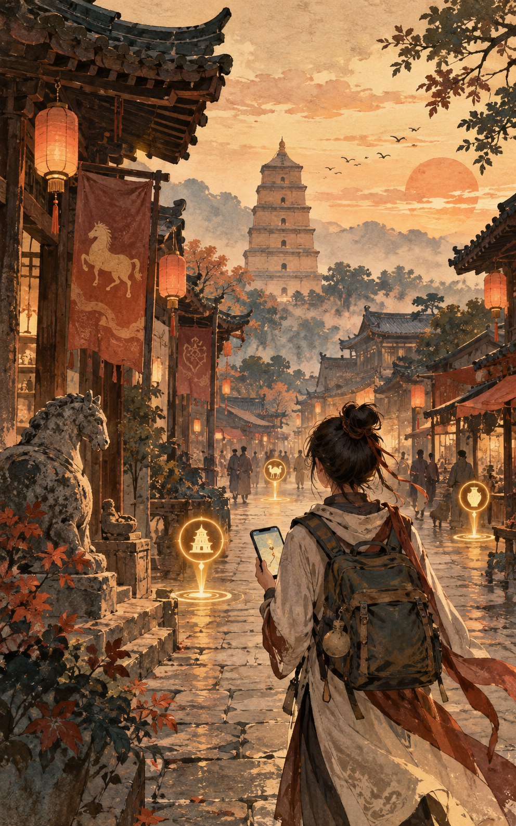
03
项目的初步想法
Initial Project Ideas

Slide 4
Background Problem 现有问题
04
TARGET USERS 目标用户
CORE PROBLEMS 核心问题
SURFACE-LEVEL VISITS
游览体验停留在表面
01 Passive interpretation
传统讲解缺少参与感
Young visitors
年轻游客
讲解员、展板和大段文字仍是主要的信息传递方式。年轻游客只能被动接收，缺少互动机会，难以持续保持注意力和探索动力。
Guides, panels and long texts dominate. Passive reception and limited interaction can weaken attention and motivation.
1 Weak cultural memory
对历史文化的记忆较弱
2 Limited emotional connection
难以与景点建立情感联系
3 Time and cost do not become meaningful cultural experiences
时间和旅行成本未转化为有意义的文化体验
4 Study tours may miss their learning goals
研学参观完成但未达到预期学习效果
希望旅行过程有趣、有参与感，同时获得一定的文化体验。
Seek an enjoyable and participatory journey while gaining cultural experience.
reveals
引出
leads to
导致
Study-tour groups
研学旅行团体
02 Check-ins disconnected from culture
打卡行为与文化理解脱节
带着学习目标参观，需要在有限时间内理解并记住文化知识。
Visit with learning goals and need to understand and retain cultural knowledge within limited time.
社交媒体推动拍照和打卡。游客可能记录景点外观，却缺少观察建筑细节、理解历史背景和建立文化联系的引导。
Photo-oriented visits may record appearances without prompting deeper observation, historical understanding or cultural connection.

Slide 5
The collision of tradition and fashion: How anthropomorphizing museum exhibits influences cultural inheritance
传统与时尚的碰撞：拟人化博物馆展品如何影响文化遗产传承
05
ORIGINAL TEXT 文献原文
LITERATURE SUMMARY 文献总结
However, traditional didactic curations and elitist stereotypes have made museums dull and unapproachable for many visitors, hindering their ability to fulfill public education and cultural inheritance functions (González-Herrera, Díaz-Herrera, Hernández-Dionis, & Pérez-Jorge, 2023; Mason & McCarthy, 2006). Therefore, it is crucial and urgent to effectively addressing these challenges.
然而，传统的教育性策展方式以及精英主义思维，使得博物馆对许多游客来说变得枯燥且难以接近，从而影响了博物馆在公共教育和文化传承方面的作用（González-Herrera, Díaz-Herrera, Hernández-Dionis, & Pérez-Jorge, 2023; Mason & McCarthy, 2006）。因此，切实解决这些挑战至关重要且迫在眉睫。
单一、刻板且陈旧的文化传播方式，会大大降低年轻群体对传统文化和古代历史的探索欲与求知欲，使观光旅途变得更加被动。
SUPPORTS
支持
Monotonous, rigid, and outdated approaches to cultural communication can greatly reduce young people's curiosity and desire to explore traditional culture and ancient history, making sightseeing a more passive experience.
Cai, S., Lin, D., & Xiao, H. (2025). The collision of tradition and fashion: How anthropomorphizing museum exhibits influences cultural inheritance. Tourism Management, 109, 105133. https://doi.org/10.1016/j.tourman.2025.105133

Slide 6
Commodification of photogenic sites and rise of “selfie parks” as tourist enclaves
具有拍摄价值的景点的商业化发展，以及“自拍公园”作为旅游聚集地的出现
06
ORIGINAL TEXT 文献原文
LITERATURE SUMMARY 文献总结
1
More recently, SNSs have inspired highly mimicked travel behaviors within destinations where travelers seek to imitate travel images created and posted by influencers and peers (Balomenou & Garrod, Citation2019; Oh, Citation2022; Siegel et al., Citation2022; Tang et al., Citation2024). To this end, travel practices have morphed. Selfies have emerged as a ubiquitous practice
近年来，社交媒体（SNS）促使旅行者在目的地中模仿大量由网红和同行所创造并发布的旅行形象，从而引发高度仿效的旅游行为（Balomenou & Garrod, Citation2019；Oh, Citation2022；Siegel 等，Citation2022；Tang 等，Citation2024）。为此，旅行方式发生了变化。自拍已成为一种普遍存在的旅行实践。
自拍逐渐成为旅游中一普遍行为
Selfies have gradually become a common practice in travel.
一些景点的作用逐渐演变为只为拍照，导致游客与该地方几乎没有其他互动
The functions of some scenic spots have gradually shifted to merely being places for taking photos, resulting in very little interaction between tourists and the area.
2
However, there is a moral gap if a place is solely used for photographic purposes and there is little other interaction between the visitors and the place (Deery et al., Citation2012). Bruner (Citation2005, p. 192) discusses ‘tourist borderzones’ as the spaces where natives and tourists come to interact.
然而，如果某个地方仅被用于拍照目的，而游客与该地方之间几乎没有其他互动，那么这就存在道德上的缺失（Deery 等人，2012 年）。Bruner（2005 年，第 192 页）将“旅游边界区”定义为当地居民和游客相互互动的空间。
To achieve the idealized types of photos that now circulate on social media, there has been a shift in performative behavior that has onsite implications (Pearce & Wang, Citation2019).Caldeira et al. (Citation2021) discussed the painstaking processes in which users engage to generate the type of posts that are considered ‘successful’ on SNSs, including engaging in extensive grooming and makeup rituals. Furthermore, Siegel et al. (Citation2022) found that social media-induced tourists exhibit nuanced travel behaviors and bring along props, costume and extensive photography equipment. Subsequently, many spend substantially more time and effort to achieve a ‘perfect photo’ in that place and time.
为了获得如今在社交媒体上广泛传播的理想化照片类型，人们的行为表现发生了变化，这种变化对现场行为产生了实际影响（Pearce & Wang, Citation2019）。Caldeira 等人（Citation2021）探讨了用户为在社交网络中生成被视为“成功”的帖子而进行的繁琐过程，包括投入大量时间进行精心打扮和化妆。此外，Siegel 等人（Citation2022）发现，受社交媒体影响的游客表现出更为细致的旅行行为，并携带道具、服装以及大量摄影设备。因此，许多人会花费更多的时间和精力，在特定地点和时间拍摄出“完美”的照片。
游客为了捕捉“完美照片”，花费大量时间经理甚至准备妆造，只为成为社交媒体上的“成功”帖子，忽略正真旅游观光的意义
Tourists spend a great deal of time planning and even preparing their makeup just to capture "perfect photos", solely aiming to create "successful" posts on social media, while neglecting the true meaning of tourism and sightseeing.
3
Siegel, L. A., Tussyadiah, I., & Scarles, C. (2025). Commodification of photogenic sites and rise of ‘selfie parks’ as tourist enclaves. Tourism Geographies, 27(6), 1184–1209. https://doi.org/10.1080/14616688.2025.2532582

Slide 7
07
Learning Curiosity through Play: Exploring the Role of Games and Interactive Design in Museums
通过游戏培养好奇心：探索游戏和互动设计在博物馆中的重要作用
ORIGINAL TEXT 文献原文
LITERATURE SUMMARY 文献总结
1
In museums, games are uniquely positioned as tools for scaffolding interaction, offering structured and exploratory experiences that guide visitors through complex ideas while adapting to their individual needs [41].
在博物馆中，游戏作为促进互动的工具具有独特优势，能够提供结构化且探索性的体验，引导参观者理解复杂概念，同时根据个体需求进行调整[41]。
Games turn museum visits into active exploration
游戏将参观转化为主动探索
将游戏融入参观过程，可以通过目标、探索和互动引导游客理解景点内容，提高参与感与整体参观体验。
Integrating games into a visit can guide understanding through goals, exploration, and interaction, creating a more engaging museum experience.
2
Scaffolding, rooted in Vygotsky's concept of the zone of proximal development, refers to the structured support provided to learners as they navigate new content, gradually reducing this support as independence increases [74].
支架式学习源于维果茨基的“最近发展区”理论，指的是在学习者接触新内容时所提供的有条理的支持，随着其独立性增强，支持程度逐步减少[74]。
In the context of game-based learning, scaffolding is embedded through mechanisms such as prompts, feedback, and progression systems that adapt to the learner's skill level, fostering curiosity while avoiding frustration [22, 25, 68]. For museums, where audiences range widely in age, background, and familiarity with both content and technology, scaffolding is a critical design principle that ensures games and interactive experiences remain both accessible and meaningful [26].
在基于游戏的学习环境中，支架式设计通过提示、反馈和进度系统等机制实现，这些机制会根据学习者的技能水平进行调整，激发好奇心的同时避免挫败感[22, 25, 68]。对于观众年龄、背景以及对内容和技术熟悉程度差异较大的博物馆而言，支架式设计是一项关键的设计原则，有助于确保游戏和互动体验既易于接触又富有意义[26]。
Adaptive scaffolding keeps challenges meaningful
自适应“支架式教学”让挑战保持合理
个性化调整--“支架式教学”，根据不同游客的能力，提供不同难度的解密问题，避免游客沮丧的同时，确保游戏和互动体验既易于理解，又具有意义，防止因为题目难度过低或者过高，让用户丧失使用兴趣。
Personalized adjustment - "Scaffolded Instruction": Based on the different abilities of tourists, different levels of decryption questions are provided to avoid tourists' frustration while ensuring that the game and interactive experience is both easy to understand and meaningful, and preventing users from losing interest due to either too easy or too difficult questions.
Grace D, T., Abel, C., & Salen Tekinbaş, K. (2025). Learning curiosity through play: Exploring the role of games and interactive design in museums. In Proceedings of the 2025 CHI Conference on Human Factors in Computing Systems (CHI ’25), Article 655, 1–14. ACM. https://doi.org/10.1145/3706598.3713164

Slide 8
08
The collision of tradition and fashion: How anthropomorphizing museum exhibits influences cultural inheritance
传统与时尚的碰撞：拟人化博物馆展品如何影响文化遗产传承
ORIGINAL TEXT 文献原文
LITERATURE SUMMARY 文献总结
1
Verbal or visual anthropomorphic cues in interpretation motivate pro-environmental behaviors through guilt (Tam, 2019), sympathy (Caldwell & Henry, 2020), or meaningful experiences (Liu, Ning, Zhang, Font, & Zeng, 2024). Cognitively, anthropomorphism satisfies effectance motivation by helping people make sense of unfamiliar entities or situations (Epley et al., 2007).
通过语言或视觉上的拟人化元素，可以激发人们采取环保行为，这种激励方式可以是出于负罪感（Tam，2019 年）、同情心（Caldwell 和 Henry，2020 年），或是为了获得有意义的体验（Liu、Ning、Zhang、Font 和 Zeng，2024 年）。从认知层面来看，拟人化设计有助于满足人们追求效果的需求，帮助人们更好地理解那些陌生的实体或情境（Epley 等人，2007 年）。
Emotional engagement supports meaningful understanding
情感投入促进意义理解
拟人化设计能够激发用户的情感需求，增强体验感，并帮助用户理解建筑或文物背后的故事、意义和价值。
Anthropomorphic design can engage visitors emotionally, strengthen the experience, and help them understand the stories, meaning, and value behind buildings or artifacts.
2
Li et al. (2023) found that museum exhibit anthropomorphism (MEA) enhances visitors' intention to know more by reducing psychological distance, suggesting MEA's potential to support museums' cultural educational significance.
As an emerging exhibition method, MEA satisfies visitors' hedonic needs for fun and pleasure (Melián-González, Gutiérrez-Taño, & Bulchand-Gidumal, 2021), inspires active exploration of artifacts' meaning and value (Epley et al., 2007; Li et al., 2023), fosters a sense of belonging and social connection, and encourages a protective attitude toward artifacts (Yang et al., 2020).
Li 等人（2023 年）的研究发现，博物馆展览中的拟人化表现能够缩短与观众的心理距离，从而增强观众想要了解更多信息的意愿，这表明拟人化表现有潜力提升博物馆的文化教育价值
作为一种新兴的展览方式，拟人化表现能够满足观众对乐趣和愉悦的渴望（Melián-González、Gutiérrez-Taño 等，2023 年）。以及 Bulchand-Gidumal 在 2021 年的研究指出，这些文物能够激发人们积极探索其意义与价值的兴趣（Epley 等人，2007 年；Li 等人，2023 年）。同时，它们还能增强人们的归属感和社会联系，并促使人们产生对文物的保护意识（Yang 等人，2020 年）。
Reduced psychological distance encourages learning
缩短心理距离，增强了解意愿
拟人化能够缩短用户与古代文物或建筑之间的心理距离，增强归属感和社会联结，促使用户产生主动了解的意愿，并展现出提升文化教育价值的潜力。
Anthropomorphism can reduce psychological distance from historical artifacts or buildings, strengthen belonging and social connection, encourage visitors to learn more, and support cultural education.
Cai, S., Lin, D., & Xiao, H. (2025). The collision of tradition and fashion: How anthropomorphizing museum exhibits influences cultural inheritance. Tourism Management, 109, 105133. https://doi.org/10.1016/j.tourman.2025.105133

Slide 9
MAIN QUEST 主线任务
09
01
针对不同的景点设置结合史实的虚拟剧情
02
每个剧情可沿景点中的某一个文物或建筑展开，将此文物或建筑拟人化，将用户也塑造成其中角色，共同推动剧情（角色扮演）
03
剧情中穿插与史实相关的解谜，谜题的答案和下一个用户将要参观的景点有关，推动剧情（解谜的难度可自由选择，适配不同用户的水平）
Create a virtual storyline grounded in historical facts for each different attraction.
Each story develops around an artifact or building at the attraction. The artifact or building is personified, while the user also becomes a character and advances the story together through role-play.
Historical puzzles are embedded in the story. Their answers relate to the next place the user will visit and move the story forward. Puzzle difficulty can be freely selected to suit different users.
06
参观完这个景点设置的全部文物或建筑即完成主线任务（运用任务和剧情）
05
成功观光过的文物，用户可随时打开看对应的介绍，有对应的3D虚拟模型收集（游戏奖励）
04
用户每观光到一个建筑或文物需拍照合影（收集记忆），成功后会有对应的史实介绍（文化解读）
The main quest is completed after visiting all artifacts or buildings assigned to the attraction, using quests and storylines.
For artifacts successfully visited, users can open the corresponding introduction at any time and collect a matching virtual 3D model as a game reward.
At every building or artifact, the user takes a photo together with it to collect a memory. After success, the corresponding historical introduction appears as cultural interpretation.
OPTIONAL BRANCH 可选支线
07
支线任务（用户可选是否完成）：景点周边的一些小文物或著名美食
Side quests are optional: small artifacts or famous foods around the attraction.

Slide 10
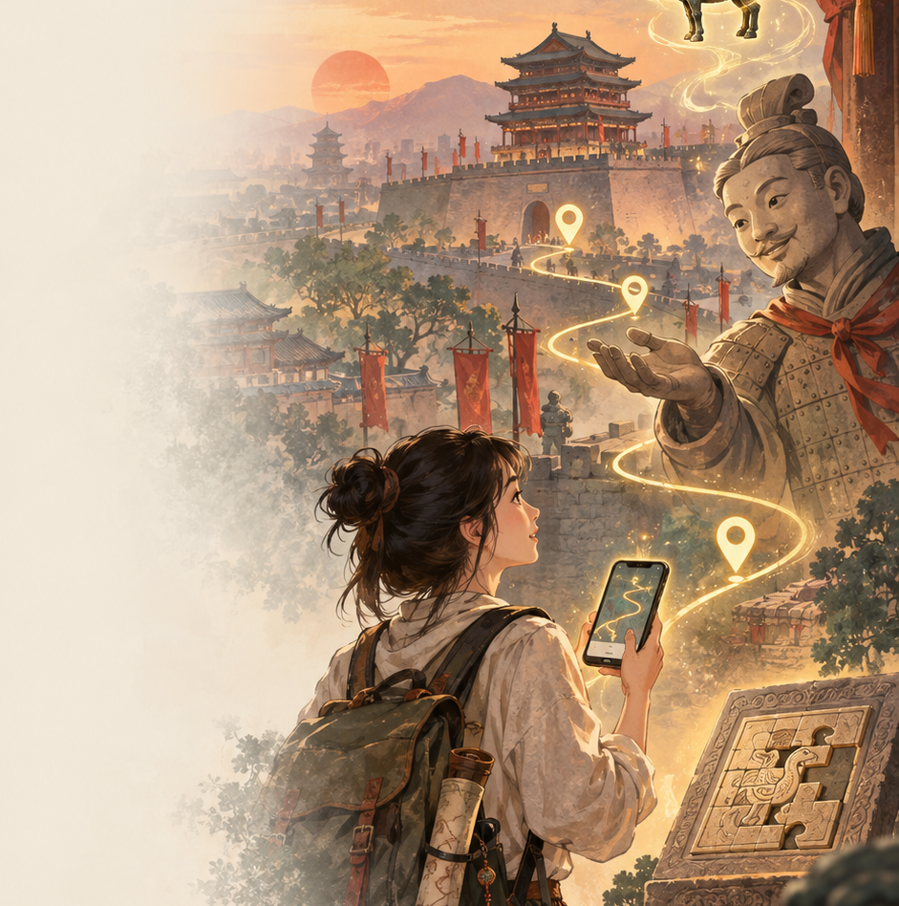
10
Main Features
主要特点

Slide 11
Main Features 主要特点
11
01
史实与虚拟剧情结合
Historical Facts + Fictional Story
04
解谜与实地路线结合
Puzzles + Physical Routes
07
文化解读与任务结合
Culture Unlocked by Tasks
针对不同景点设计独立剧情。虚构的游戏情节以真实历史事件、人物、文物和建筑为基础。
历史谜题的答案提示下一个景点，使解谜、剧情和现实参观路线相互连接。
用户亲自到达地点并完成任务后解锁文物介绍，让文化知识成为探索成果，而不是被动灌输。
Each site has an independent fictional storyline grounded in real events, people, artifacts and architecture.
Historical puzzle answers reveal the next destination, connecting gameplay, story progression and the real route.
Cultural interpretation unlocks after on-site tasks, turning knowledge into a reward for active exploration.
02
文物和建筑拟人化
Personified Heritage
05
自适应谜题难度
Adaptive Puzzle Difficulty
08
3D模型收藏和游戏奖励
3D Collection + Rewards
将文物或建筑设计成故事角色，通过对话介绍自己的历史和故事，拉近游客与文化遗产的心理距离。
用户可按能力选择难度，适配不同年龄、知识水平和游戏经验，避免过难受挫或过易失去兴趣。
完成文物或建筑任务后获得对应的虚拟3D模型。已解锁的模型和历史介绍可随时在个人收藏中查看。
Artifacts and buildings become speaking characters, making their stories more approachable and reducing psychological distance.
Selectable difficulty supports different ages and experience levels while preventing frustration or boredom.
Completed missions unlock 3D models and historical information for later viewing in the personal collection.
03
游客参与角色扮演
Visitor Role-play
06
拍照验证与“收集记忆”
Photo Verification + Memories
09
主线与支线任务
Main and Optional Side Quests
用户成为故事中的角色，通过互动、接受任务和作出选择推动剧情，而不只是观看剧情。
用户到达指定建筑或文物后拍照或合影。验证成功后，系统将这次参观记录为一段“旅行记忆”。
完成全部指定文物或建筑即完成主线。用户还可探索小型文物、特色地点或美食，且不影响主线进度。
Visitors enter the story as characters and move it forward through interactions, missions and choices.
After photo verification at the target, the system records the visit as a collectible travel memory.
The main quest covers required heritage sites. Optional side quests explore smaller artifacts, local places and food.

Slide 12

12
THANK YOU
谢谢大家

